Slide 1
Automated Generation of Dynamic Binary Translators for Instruction Set Simulation
Katsumi Okuda, Minoru Yoshida, Haruhiko Takeyama, Minoru Nakamura
Advanced Technology R&D Center, Mitsubishi Electric Corporation, Japan
2017 22nd Asia and South Pacific Design Automation Conference (ASP-DAC)

Slide 2
Goal
propose a novel framework that generates ISSs based on dynamic binary translation and these ISSs will faster than original DBT-base ISSs

Slide 3
Instruction Set Simulation
used to develop new architectures
two kinds of ISSs are widely used:
interpreters and dynamic binary translators (DBTs)
Interpreter
slow, easy implementation
DBT
fast, difficult implementation

Slide 4
Framework
generates a DBT from the description of an interpreter
compiles instruction specific behavior functions for the interpreter into an object file using a host compiler
generates translation functions for the DBT by extracting the translation template from the object file

Slide 5
DBT
executes target instructions by translating them into host instructions
skip decoding the instructions and extracting the instruction fields when the DBT executes target instructions already translated,

Slide 6
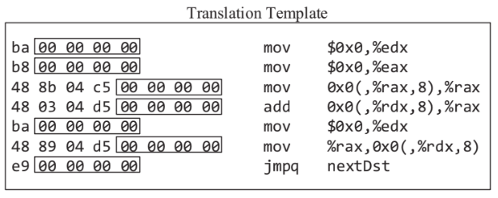
Translation Template
DBT can generate host instructions by expanding a translation template in the translation cache and substituting values available at the translation time for template parameters.
contains the following parameters
instruction field
program counter
symbol address
template of DADD in MIPS64

Slide 7
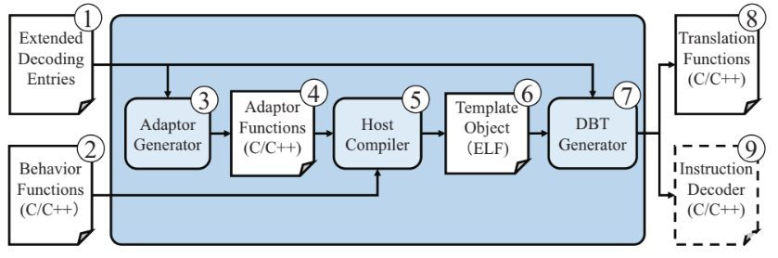
DBT Generation

Slide 8
Extended Decoding Entry
generate both the instruction decoder and the translation functions
composed of the following items
instruction name
pattern
exclusion conditions
instruction fiedl information
instruction type
branch type
delay slot count

Slide 9
Behavior Function
behavior function written in C/C++ emulates a target instruction
establishes a description guideline of behavior functions, so that their compilation results can be used as a translation template.

Slide 10
Description Guidelines
function signature
function name equal the instruction name
first parameter is PCvalue
order of subsequent parameters must be the same as order of the instruction fields
resource access
Target resources such as registers must be mapped to global variables.
host compiler translates the global variables used in behavior functions into relocatable symbols
DBT generator treat the relocatable symbols as template parameters
reserved variable
NEXT_PC, BRANCH_RESULT

Slide 11
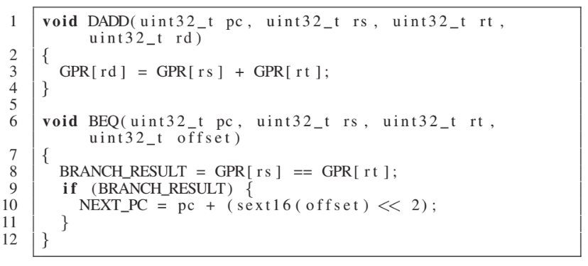
Behavior Funtion Example

Slide 12
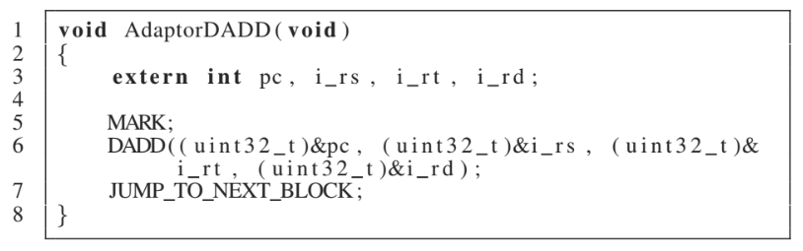
Adaptor Function
allow the DBT generator to use the compilation results of the behavior functions as translation templates

Slide 13
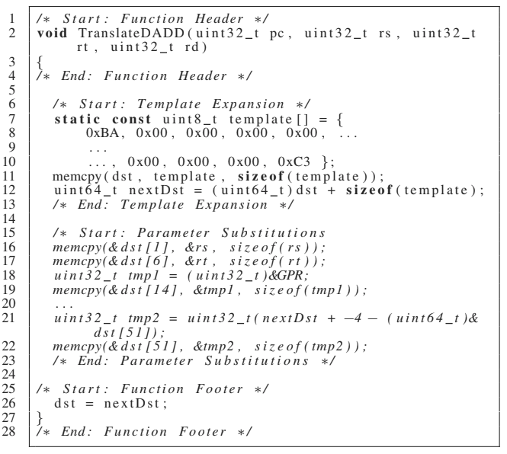
Translation Function
function header
template expansion
parameter substitution
function footer

Slide 14
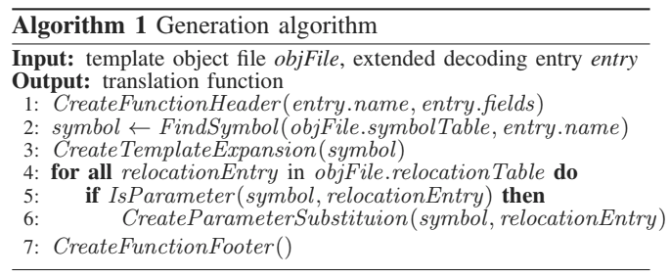
Algorithm

Slide 15
Experimental Results
ISSs for SH, MIPS64, and ARM
64-bit Core-i7 2.8 GHz, Linux-based desktop machine with 16-GB main memory
gcc 4.9.2

Slide 16
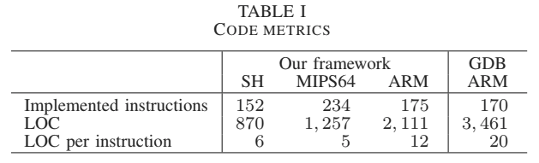
Productivity

Slide 17
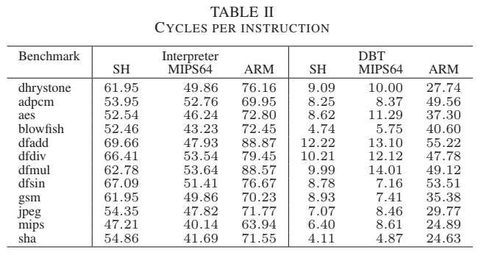
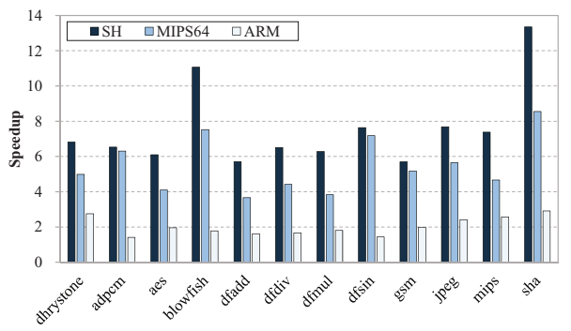
Simulation Speed
1.4 to 13.4 times faster than their original interpreters

Slide 18
Conclusion
addresses the difficulty of implementing a dynamic binary translator (DBT).
The simpler the target instructions are or the longer the DBBs of the target program, the more speedups tend to be achieved

